Slide 1
Route Planning
20210114
Student: Yang-Hang Wu
Supervisor: Kuo-Shen Chen

Slide 2
Outline
0. Previous Problems
1. Graph
2. Single-Source Shortest Path
Exhaustive solution
Greedy
Dynamic Programming Dijkstra (Optimal Solution)
3. Visualization

Slide 3
Previous Problems
1. Hand made instructions
Lots of preprocessing for instructions
Lack of flexibility
Not shortest path
2. Not robust (if ID8 is missing)
command
00,2;01,2;03,3;04,2;05,5;06,1;07,3;08,4;09,1;10,4;11,4;

Slide 4
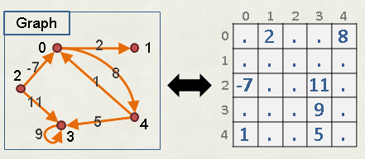
Graph (Directed Graph)
0
3
6
8
9
 | 0 | 1 | 2 | 3 | 4 | 5 | 6 | 7 | 8 | 9 | 10 | 11
0 |  | 13 |  | 2
1 |  |  | 2 |  |  | 1
2 |  | 1
3 |  |  | 10 |  |  |  | 2
4 |  |  | 1 |  |  |  |  | 6
5
6 |  |  |  |  | 1
7 |  |  |  |  |  | 10
8 |  |  |  |  |  |  |  |  |  | 1
9 |  |  |  |  |  |  |  |  |  |  |  | 3
10 |  |  |  |  |  |  |  |  | 12
11 |  |  |  |  |  |  |  |  |  |  | 5
2
2
1
13
10
1
12
3
1
1
5
1
2
4
10
11
2
Adjacency matrix
1
10
6
5
7
Real map
Excel file

Slide 5
Single-Source Shortest Path
Exhaustive solution – high computational load
Greedy – not optimal
Dynamic Programming - Optimal Solution
Use table to memorize previous work to save repeated calculations
Trade off between time and memory(以空間換取時間)
最佳解的子集合也為最佳解

Slide 6
Dijkstra's Algorithm
Premise: Weight must be non-negative real number
Bottom up
Time Complexity O(|V²|)

Slide 7
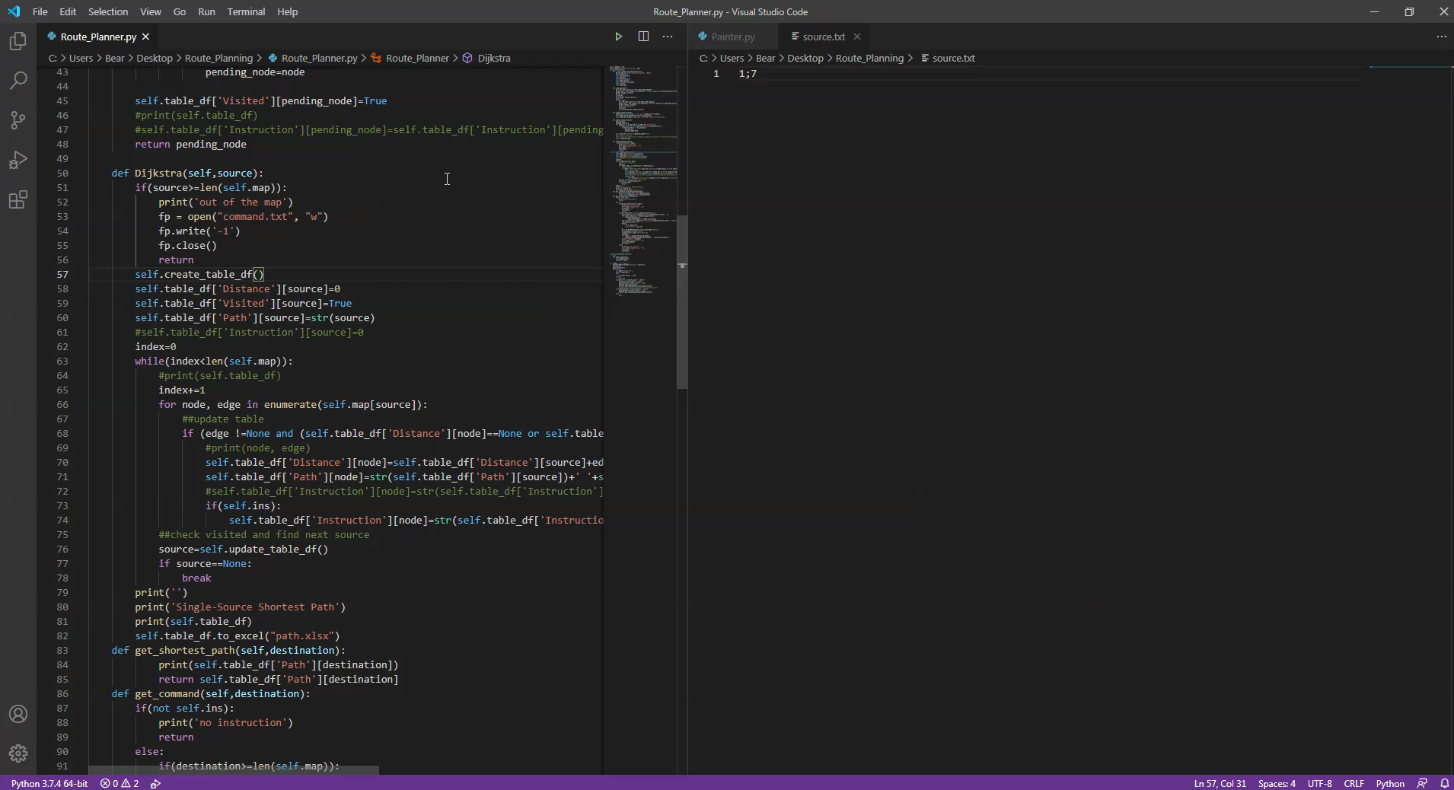

Slide 8
Dijkstra's Algorithm
Distance Visited Path Instruction
0 0 True 0
1 13.0 False 0 1 3
2 None False None
3 2.0 0 3 2
4 None False None
5 None False None
6 None False None
7 None False None
8 None False None
9 None False None
10 None False None
11 None False None
0
3
6
8
9
3
2
2
1
13
10
1
12
3
True
1
False
1
2
1
4
10
5
11
2
1
6
10
5
7

Slide 9
Relaxation
Distance Visited Path Instruction
0 0 True 0
1 13.0 False 0 1 3
2 6.0 True 0 3 6 4 2 2 2 3 4
3 2.0 True 0 3 2
4 5.0 True 0 3 6 4 2 2 3
5 None False None
6 4.0 True 0 3 6 2 2
7 11.0 False 0 3 6 4 7 2 2 3 3
8 None False None
9 None False None
10 None False None
11 None False None
0
3
6
8
9
2
2
1
13
10
1
12
3
1
1
1
2
4
10
5
11
2
1
6
10
5
7
d[2]+1<d[1]

Slide 10
Relaxation
Distance Visited Path Instruction
0 0 True 0
1 7.0 True 0 3 6 4 2 1 2 2 3 4 4
2 6.0 True 0 3 6 4 2 2 2 3 4
3 2.0 True 0 3 2
4 5.0 True 0 3 6 4 2 2 3
5 None False None
6 4.0 True 0 3 6 2 2
7 11.0 False 0 3 6 4 7 2 2 3 3
8 None False None
9 None False None
10 None False None
11 None False None
0
3
6
8
9
2
2
1
13
10
1
12
3
1
1
1
2
4
10
5
11
2
1
6
10
5
7

Slide 11
Visualization
0
3
6
8
9
2
2
1
13
10
1
12
3
1
1
5
1
2
4
10
11
2
1
10
6
5
7

Slide 12
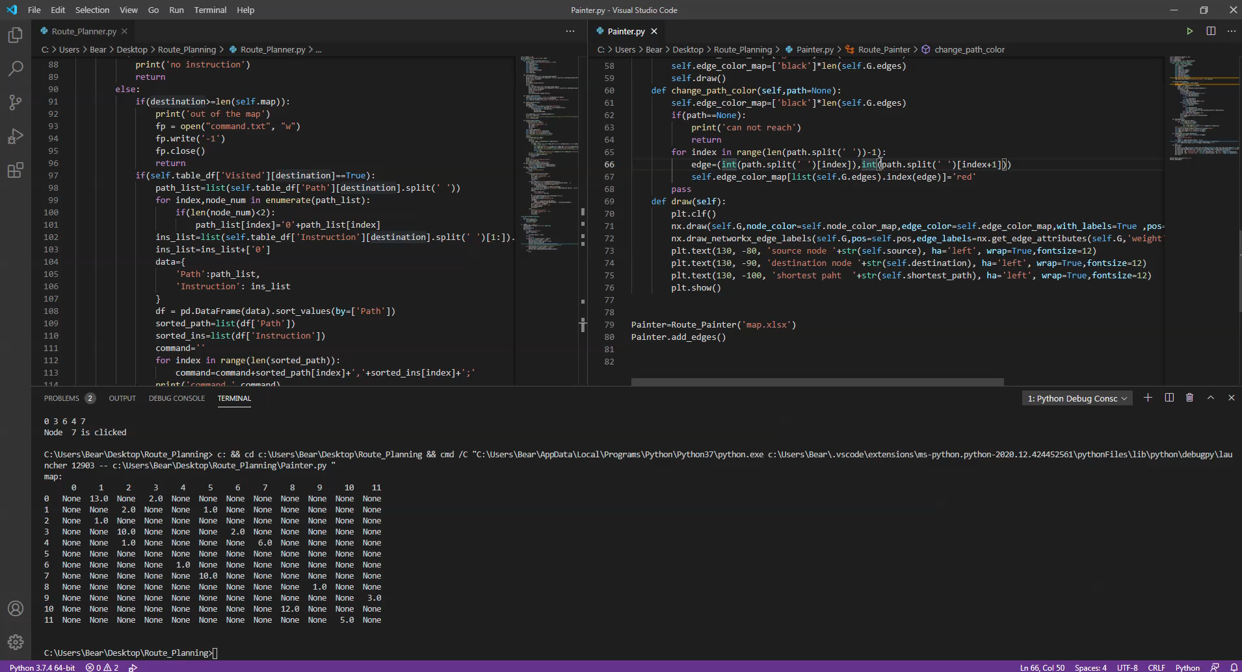

Slide 13
Future work
1. Graph layout
2. Label blocked

